Slide 1


Social Buzz

Slide 2


Today's agenda
TTo provide the high level overview to the business problem we’re tackling and the practice requirements, we will provide a summary of the entire project
r
Project Recap
Project recap
Problem
The Analytics team
Process
Insights
Summary
WWe will get into a particular issue that the Data Analytics team has been concentrating on and provide some context for why this in such a significant issue
Problem
I’ll start Outlining the issue and then discuss the Team that is in charge of handling this assignment on our end
The Team Analytics
After that ,I'll go into the generator steps we look to do this assignment so you can fully understand how we approach tasks of this nature
Process
Lastly ,’ will review at significant trending and offer them as a collection of understanding and Illustration form our
Insights and Summary

Slide 3


Social Buzz is a fast growing Technology unicorn that need
to adapt quickly to it’s global scale .Accenture begun month POC focusing on these tasks:
An audit of social Buzz’s big data practice
Recommendation of successful IPO
Analysis to Analysis to find Social Buzz’s top 5 most Popular Categories of content
Project Recap

Slide 4


Problem
In recent years,the customers has gained to enormous extent and they lack the internal resources to manage it
Every day,Social Buzz receives over 160,00 posts, totaling 36,500,000 post annually,since all of content is unstructed ,it might be challenging to make sense of all it
Determine the specifications that must be fulfilled for this project
Combining tables from the sample dataset
An analysis of their content categories that identifies the top five with the highest total popularity

Slide 5



Sr Data Analyst
The Analytics team
Data Analyst
Jr Data Analyst

Slide 6

Process
1
Data Understanding
Data Cleaning
2
Data Modelling
3
4
Data Analysis
5
Uncover Insights

Slide 7


Insights
75k
May
16
REACTION TO “ANIMAL” POSTS
MONTH WITH MOST POST
UNIQUE CATEGORIES

Slide 8
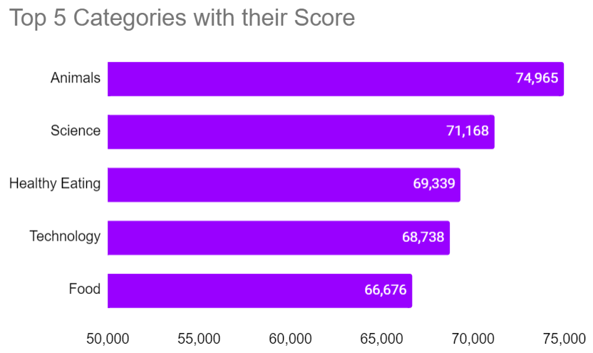

Slide 9
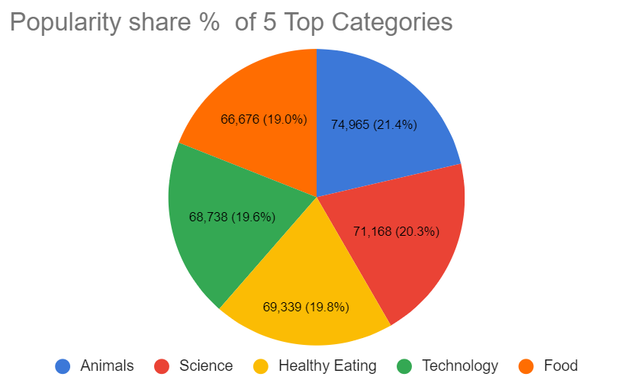

Slide 10


Analysis
Animals and science are two most Popular categories of content ,showing that people enjoy “real-life” and “factual” content the most.so I would recommend that you keep creating more relating to these two categories
Insights
Food is a common Theme with the top 5 Categories with ‘Healthy Eating ’ Ranking as one of the highest ,this may give an indication to the audience within your use base you could use this insights to create a campaign and work with healthy eating brands to boost user engagement
Summary
Nest 5 Step
It should be come as no surprise that technological content is among the top categories given the advancement of technology.it indicated that users like your technological material working with some of the biggest digital companies in the world is something I would suggest doing because it would suggest suggest doing because it would undoubtly increase user engagement

Slide 11

Thank you!
ANY QUESTIONS?

